Slide 1
DEEP LEARNING (SEP 740)
Heart Disease Prediction Using Deep Learning Neural Network
Guided By: Sayyed Faridoddin Afzali
Henis Nakarani (400547270) Ritul Koladiya (400544634) Hardik Navadiya (400547048) Sahil Bhuva (400547052)
Darshan Parbadiya (400544636)

Slide 2
Introduction
Heart disease remains a leading cause of dying in the United States, emphasizing the critical need for effective preventative measures and early detection. This project leverages data from the Behavioral Risk Factor Surveillance System (BRFSS) 2015, a comprehensive health-related telephone survey conducted by the CDC. With a focus on binary classification of heart disease, the dataset, comprising 253,680 responses, presents a significant class imbalance, with 229,787 respondents without heart disease and 23,893 with a history of heart disease.

Slide 3
Problem Statement
The project aims to develop a deep learning model to predict the risk of heart disease based on survey responses and health-related risk factors.
Heart disease is a leading cause of mortality, and early prediction can help in preventive measures and early interventions.
OBJECTIVE
Develop a robust deep learning model using survey responses and health-related risk factors from the BRFSS 2015 dataset to accurately predict the risk of heart disease, contributing to early detection and intervention strategies for improved public health outcomes.

Slide 4
Data set Description
Here's a numerical breakdown of the features in the dataset:
HeartDiseaseorAttack (Target variable)
HighBP
HighChol
CholCheck
BMI
Smoker
Stroke
Diabetes
PhysActivity
Fruits
Despite of having these 22 features, our
set has more than two lakhs data points.
Veggies
HvyAlcoholConsump
AnyHealthcare
NoDocbcCost
GenHlth
MentHlth
PhysHlth
DiffWalk
Sex
Age
Education
Income

Slide 5
In our heart disease prediction project, we utilize several Python libraries to build and train our artificial neural network (ANN). Here are the key libraries we rely on:
NumPy: Used for data manipulation, feature engineering, and preprocessing.
Pandas:
for data analysis and manipulation.
For loading, cleaning, and organizing the dataset.
DataFrames for tabular data representation.
Matplotlib and Seaborn:
Matplotlib for creating visualizations
TensorFlow
TensorFlow For Defining and training neural networks efficiently.
Scikit-learn (sklearn):
preprocessing functions (e.g., scaling, encoding).
Useful for splitting data into training and test sets.

Slide 6
Method and technique used
Data Preprocessing and Feature Engineering:
Gather diverse patient records from Kaggle
Clean, scale, and encode features.
Model Architecture:
Design ANN with input, hidden, and output layers.
Utilize activation functions (e.g., ReLU, sigmoid, Linear).
Hyperparameter Tuning:
Experiment with learning rate, dropout-rate, batch size, epochs, Optimization functions, loss function etc.
Optimize using cross-validation k-fold cross validation.
No of units per hidden layer, no of hidden layers.
Regularization Techniques:
Prevent overfitting (regularization, dropout).

Slide 7
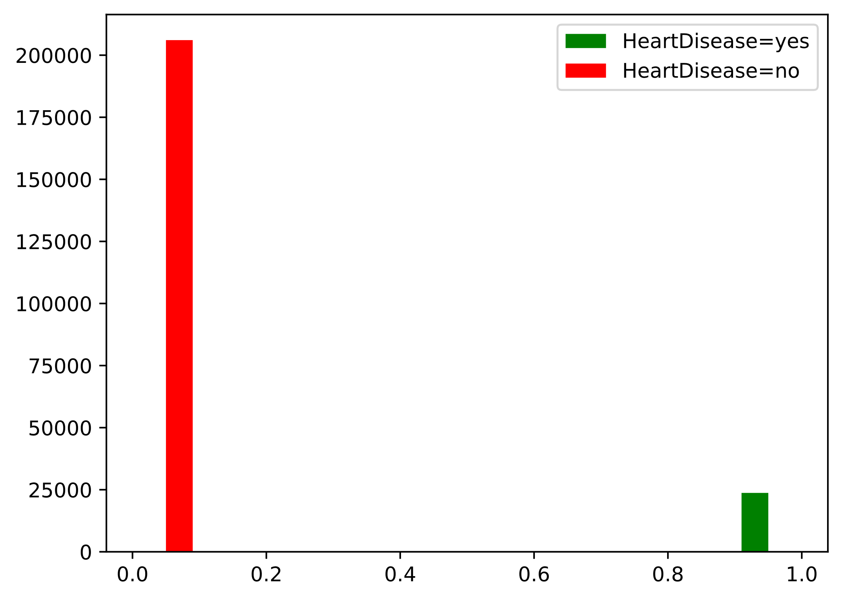
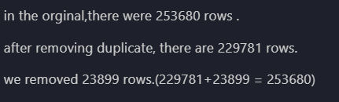
Data Preprocessing

Slide 8
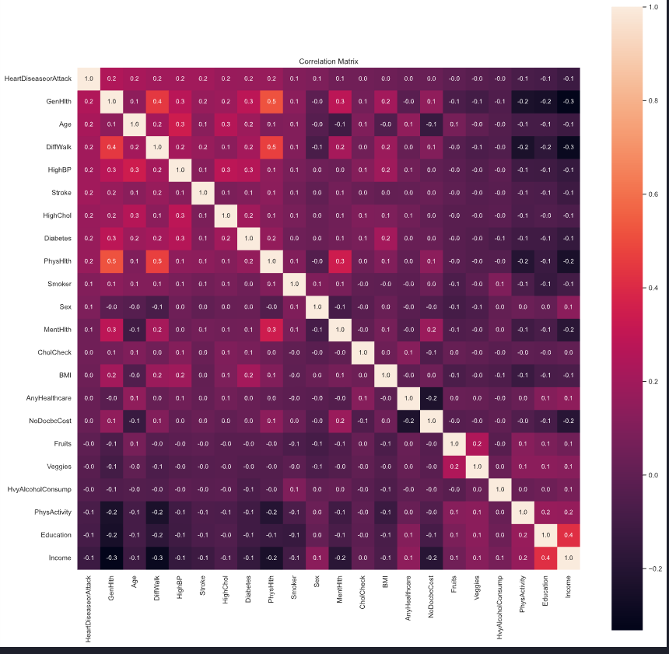

Slide 9
Problem we have tackled during project
While working on this project, we faced challenges with too many features, making things more complicated. We solved this problem using hit map correlation matrix. We reduced six columns.
Dealing with an imbalanced dataset also caused issues, like the model learning in a biased way and performance metrics getting skewed. Overfitting, where the model is great with training data but struggles with new data, added another layer of complexity. To solve that problem we used SMOTE resembling method.
To handle the heavy computing needed for training deep neural networks, we made our project more efficient. We used GPU acceleration and distributed training to make things scale better and use resources wisely.
Training our model took a long time in training. To Solve that problem, we used mini batch to reduce training time and improve efficiency of model.

Slide 10
Hyperparameter Tuning

Slide 11
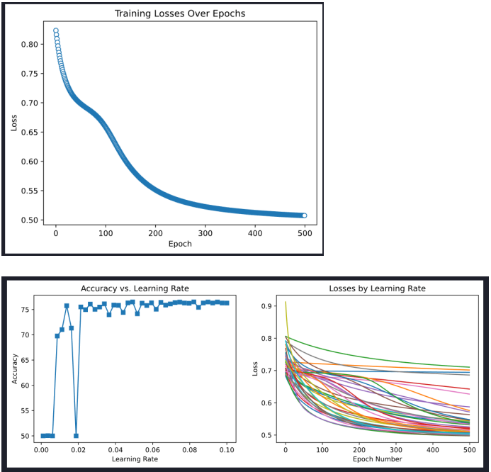
Hyperparameters
Learning rate and epochs
Learning Rate : 0.07 (Static)
Epochs : 500

Slide 12
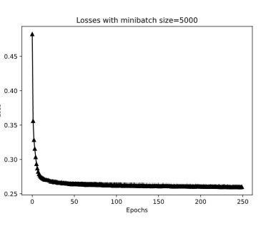
Mini batch
5000

Slide 13
Hyperparameter tuning
Number of hidden layers : 2
Number of Units in Hidden layer : 16
Activation Function : ReLU
Loss Function : Binary Cross Entropy Logit loss function
Optimizer : Stochastic Gradient Decent
Drop out Rate : 0.30
Batch Normalization
Cross Validation : K Fold Cross validation (7 Folds)

Slide 14
Result
In assessing our heart disease prediction model, a notable difference in performance was observed between training and testing phases. While the model achieved a 50% accuracy in training, its true effectiveness surfaced during testing, where it demonstrated an impressive 89% accuracy. This substantial leap highlights the model's ability to generalize well to unseen data.

Slide 15
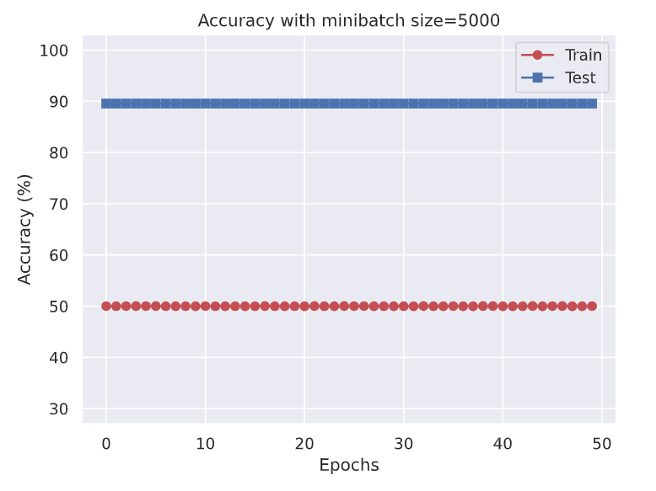
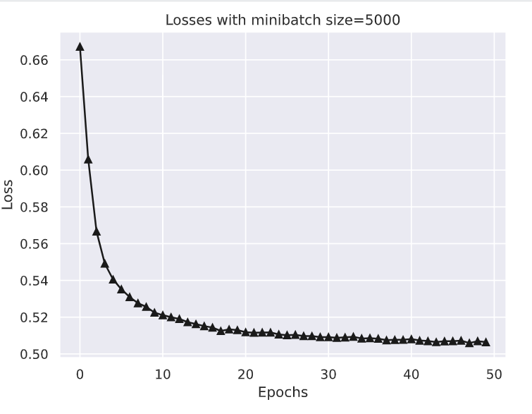
Resulting graph of Accuracy
Decrement of Loss with increment of No. of Epochs

Slide 16
Evaluating Model Performance
Cross-validation
F1 score

Slide 17
Cross-validation
Training and Testing using Cross-validation to assess how well a model generalizes to an independent dataset.
Its primary purpose is to provide a more accurate estimate of a model's performance by using the entire dataset for both training and testing, thereby reducing the risk of overfitting.
The value of k=7 was selected on purpose, considering a bunch of experiments where different values of k were tested to see how it affects model’s accuracy.
Handling Class Imbalance: Using SMOTE
At first, our model demonstrated an encouraging average accuracy of 89% across folds. However, recognizing the imbalance in our dataset, we implemented SMOTE to address this issue. Post-SMOTE, our accuracy slightly decreased to 75%, reflecting a more balanced and robust performance across different classes. The adjustment with SMOTE aimed to enhance the model's ability to handle imbalanced data, demonstrating its impact on overall accuracy.

Slide 18
Optimizing Neural Network Performance
Initially, we employed the sigmoid activation function in every hidden layer, which resulted in longer training times and cross-validation timings. Seeking optimization, we transitioned to the rectified linear unit (ReLU) activation function. This modification significantly reduced our training time. The switch to ReLU not only expedited the training process but also maintained or improved the model's learning capabilities, showcasing the impact of activation function choice on the efficiency of our neural network training.

Slide 19
Evaluating Model Performance using F1 score
Confusion matrix as a comprehensive tool for evaluating classification model performance.
Components: True Positives, True Negatives, False Positives, False Negatives.
Adjusting Threshold value :
By manipulating the threshold, we aimed to strike a balance between precision and recall, adapting our model to the specific requirements of our application.
We choose threshold value to be 0.4 while checking confusion matrix and f1 score.

Slide 20
Results
While experimenting with our model, we encountered a notable trade-off between accuracy and F1 score. Using SMOTE to address class imbalance resulted in an F1 score of 75%, indicative of improved performance in handling minority classes. Surprisingly, when working with the unbalanced dataset, the accuracy reached 89%, showcasing a different aspect of overall model performance. This discrepancy highlights the importance of considering multiple metrics to gain a comprehensive understanding of a model's behavior in different contexts.

Slide 21
Conclusion and key findings
In conclusion, the development of a heart disease prediction model using machine learning techniques is a significant step toward improving healthcare outcomes. The model can assist healthcare providers in risk assessment and early intervention, ultimately leading to better patient care. However, it is essential to keep in mind that these models are not a replacement for clinical experience. They should be used as decision support tools, with medical professionals making the final diagnoses and treatment decisions.
Key Findings:
Feature Importance: The model identifies key features that strongly influence the risk of heart disease. These may include factors such as age, blood pressure, cholesterol levels, and ECG results.
Accuracy and Performance: The model's performance metrics, such as accuracy, precision, recall, and F1-score, provide an assessment of its effectiveness in classifying individuals with or without heart disease.

Slide 22
THANK YOU

